Slide 1


Reception Transition Meeting
Monday 11th July 2022
Ash Grove Primary Academy
Nurturing Minds and Hearts – Inspiring Bright Futures
Lisa Pugh – Assistant Headteacher

Slide 2

Vision and Values
At Ash Grove Primary Academy we are committed to supporting our children to be the best that they can be. We are:
Proud of our community and our heritage and we know that together we can achieve more
Ambitious for our children and have high expectations of what they can achieve
Committed to engaging and inspiring learners by expanding their world, vocabulary and experiences
Supportive of learners in a positive culture where all are confident to try and believe they can succeed
Tolerant and understanding of others who are different to ourselves
These five aims are threaded through everything we do each day to help nurture the best in everyone.

Slide 3
Ash Grove Values
At Ash Grove, we have 4 core values that we teach the children and that thread through everything we do across school. They link into our aims for the school and also to our behaviour policy. We aim to teach children these values and help them to identify them in action in themselves, their classroom, their school, their family their wider community and globally in the world beyond.
Showing responsibility – We aim to teach children to be responsible citizens who contribute to their community, take personal responsibility for the choices they make and the decisions they take.
Showing respect – We aim to teach children to respect themselves and others, to always be kind and to demonstrate respect and understanding for those who are different to themselves.
Showing appreciation – We aim to teach children to demonstrate gratitude for the gifts that they have, to show appreciation for themselves and others and for the world around them.
Showing aspiration – We aim to open our pupils’ eyes to all the possibilities in life so that they can aspire to be what they want to be.

Slide 4
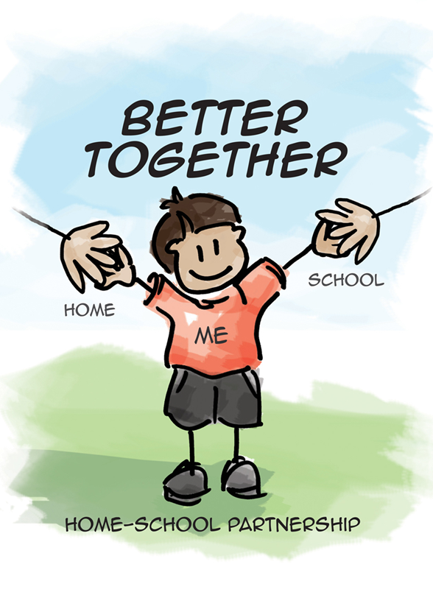
The aims of this meeting…
To help you feel informed about your child’s transition to Reception (also known as Upper Foundation Stage).
To answer any questions or queries you may have.
To make you feel at ease with the transition process.

Slide 5
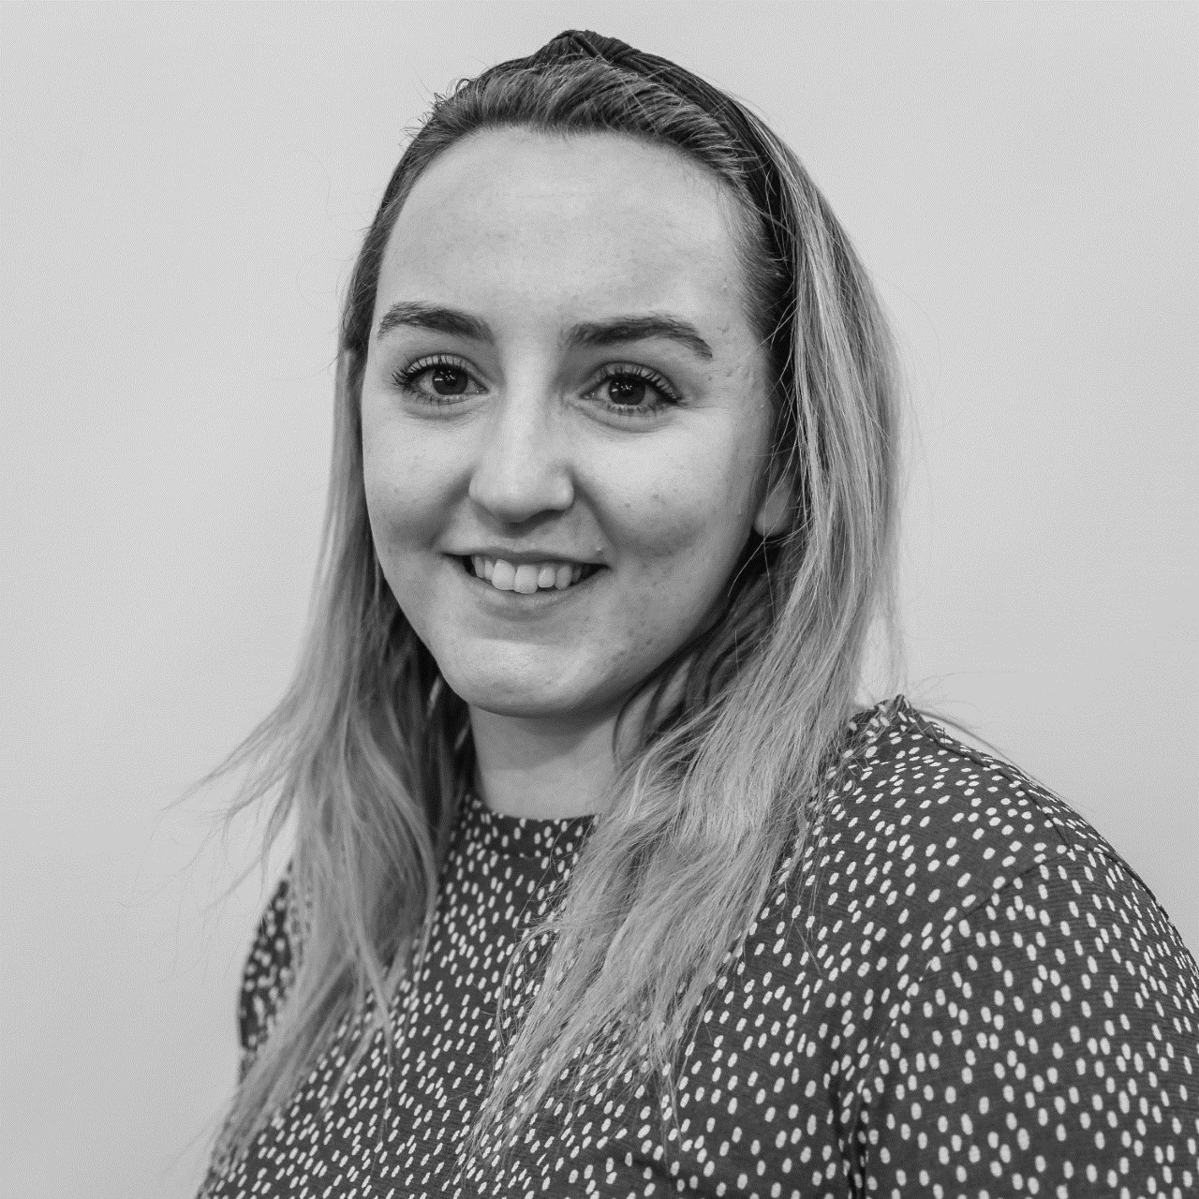
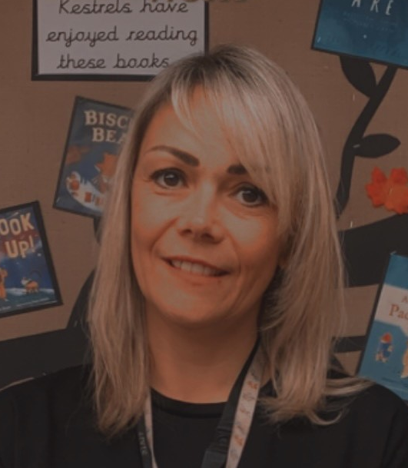
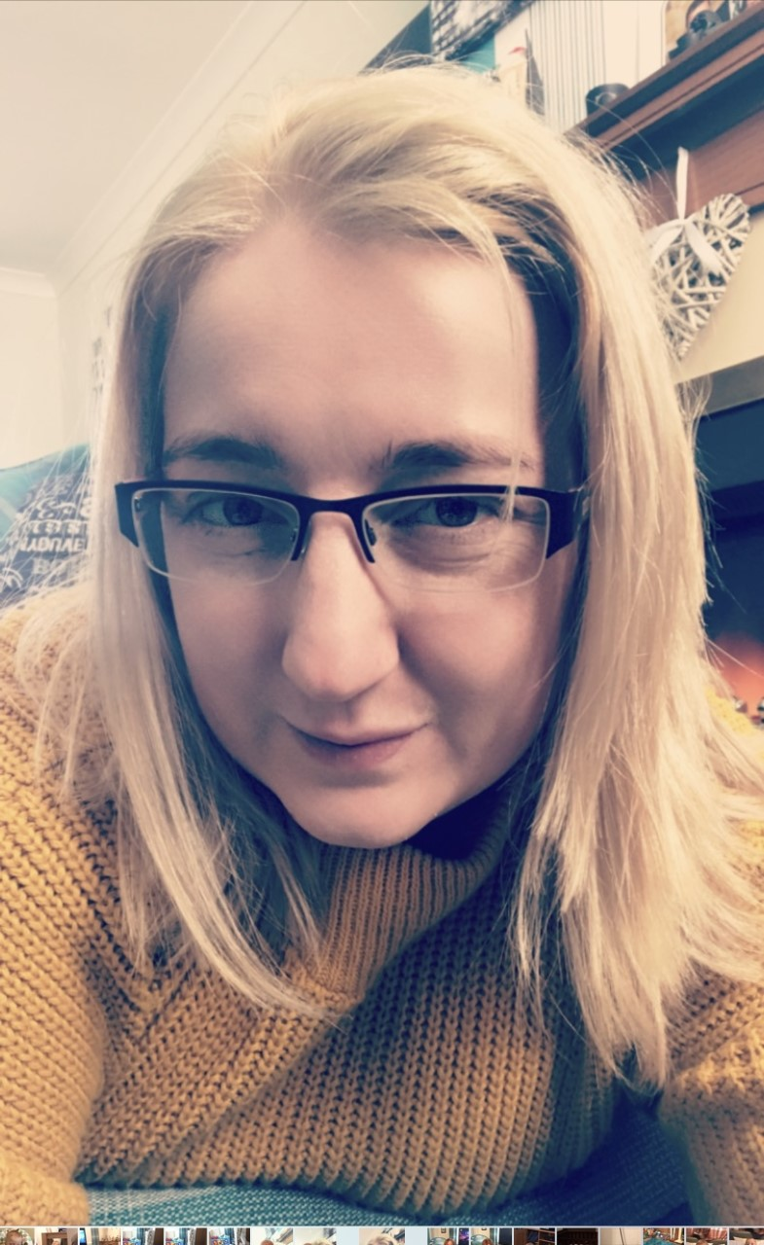
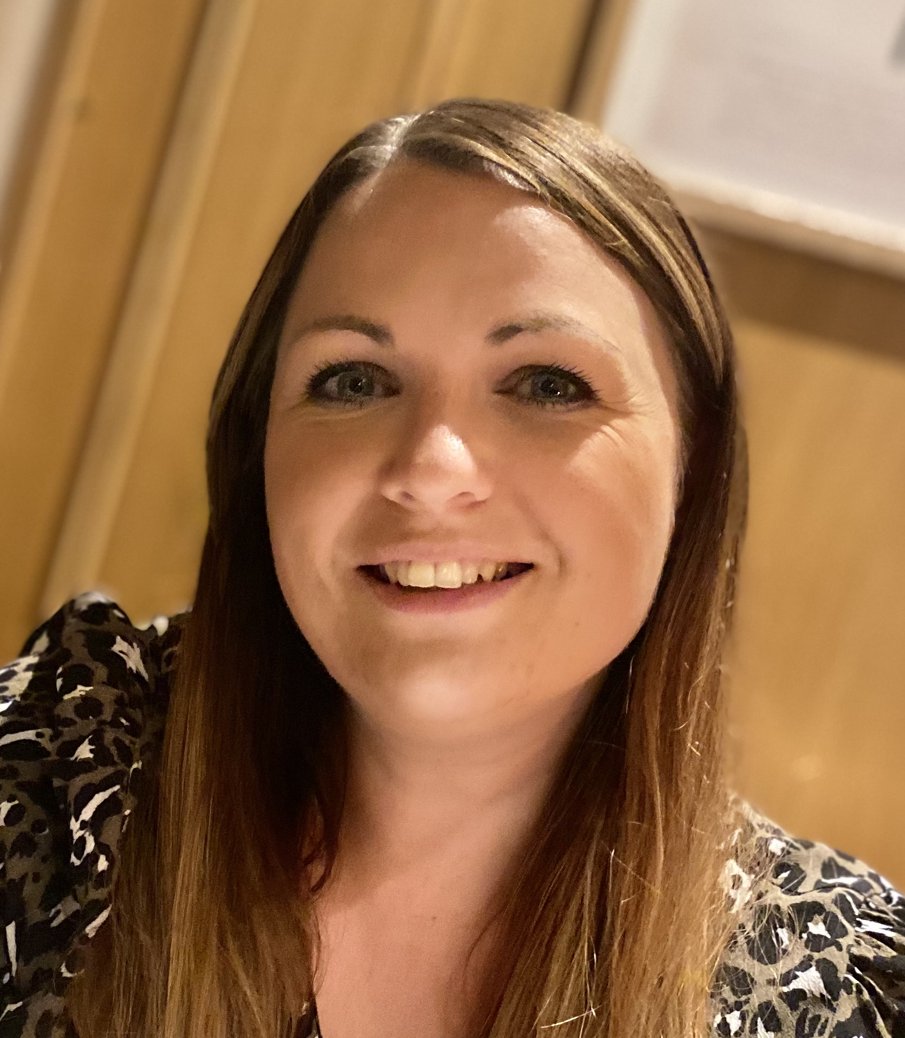
Meet the Reception Team
Miss White
Reception Class Teacher
Mrs K Sellars
Teaching Assistant
Mrs C Goodwin
Teaching Assistant
Mrs L Pugh
Assistant Headteacher & Early Years Leader

Slide 6

Starting Date
After the summer holiday, we return to school on Wednesday 7th September. All children who currently attend nursery will start on this day and stay for the full day (including lunch).

Slide 7
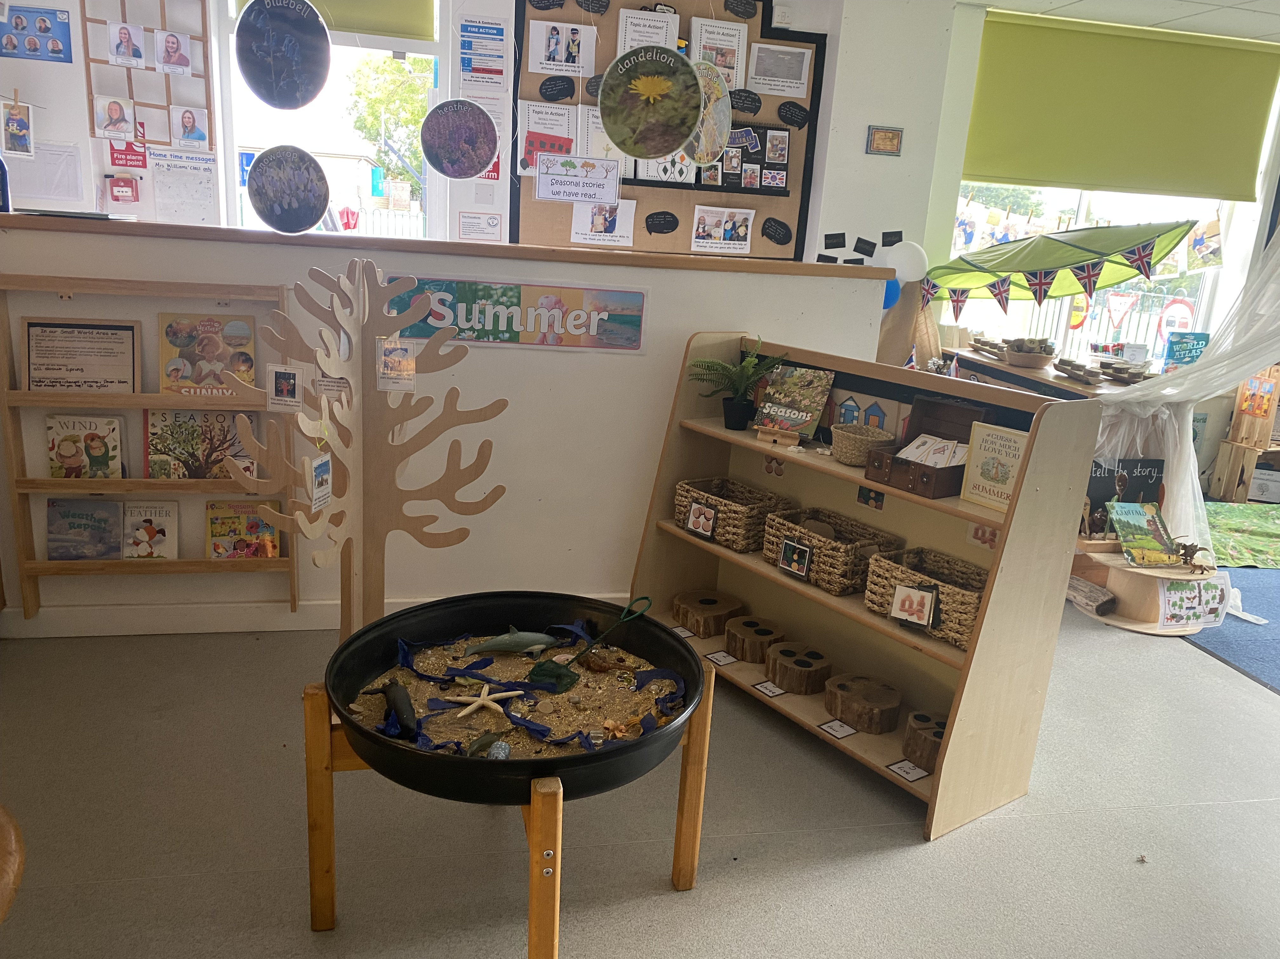
The School Day
(Times may change for September – under review)
Doors open at 8.45am and close at 9am.
Home time is at 3.15pm.
Throughout the day, children
will take part in short carpet
sessions, group activities,
indoor provision and outdoor
provision.

Slide 8

Collecting Your Child
All children must be brought and collected by a parent, carer or by a named adult over the age of 16.
If it is going to be someone other than yourself, we need this
information in advance to ensure the safety of your child.
Please also advise us if there are any specific rulings in place regarding legal access or a change of name.

Slide 9
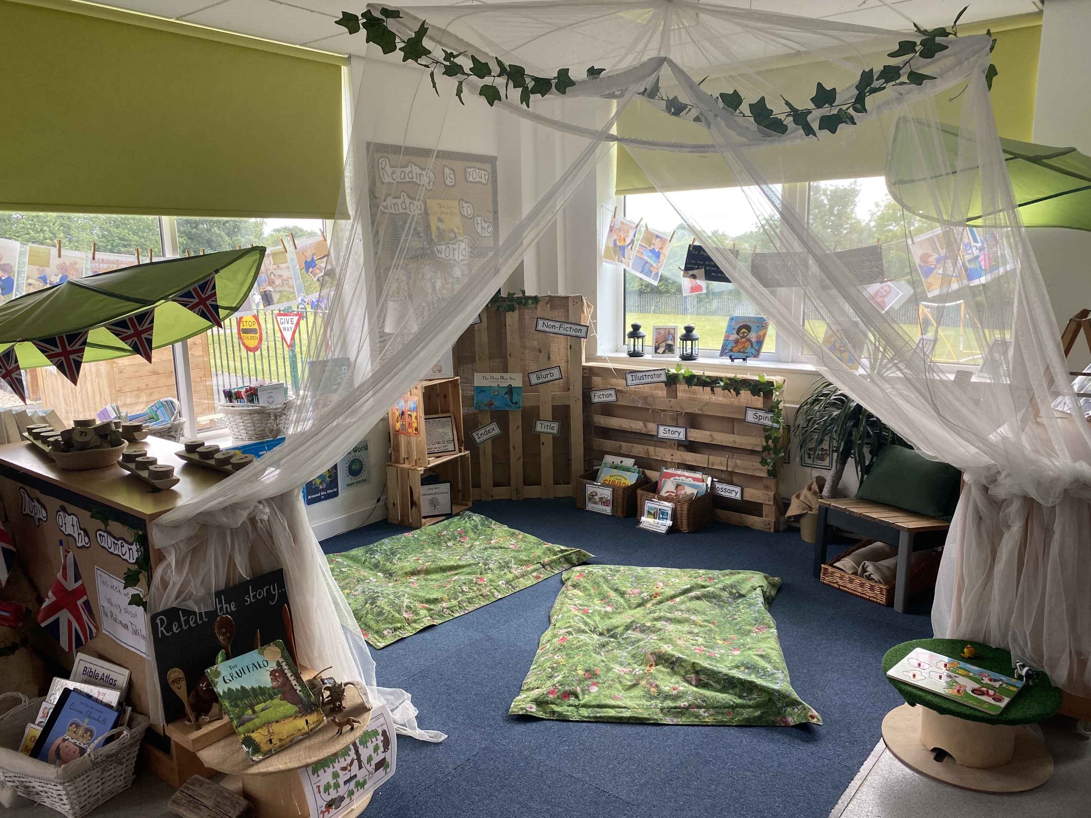
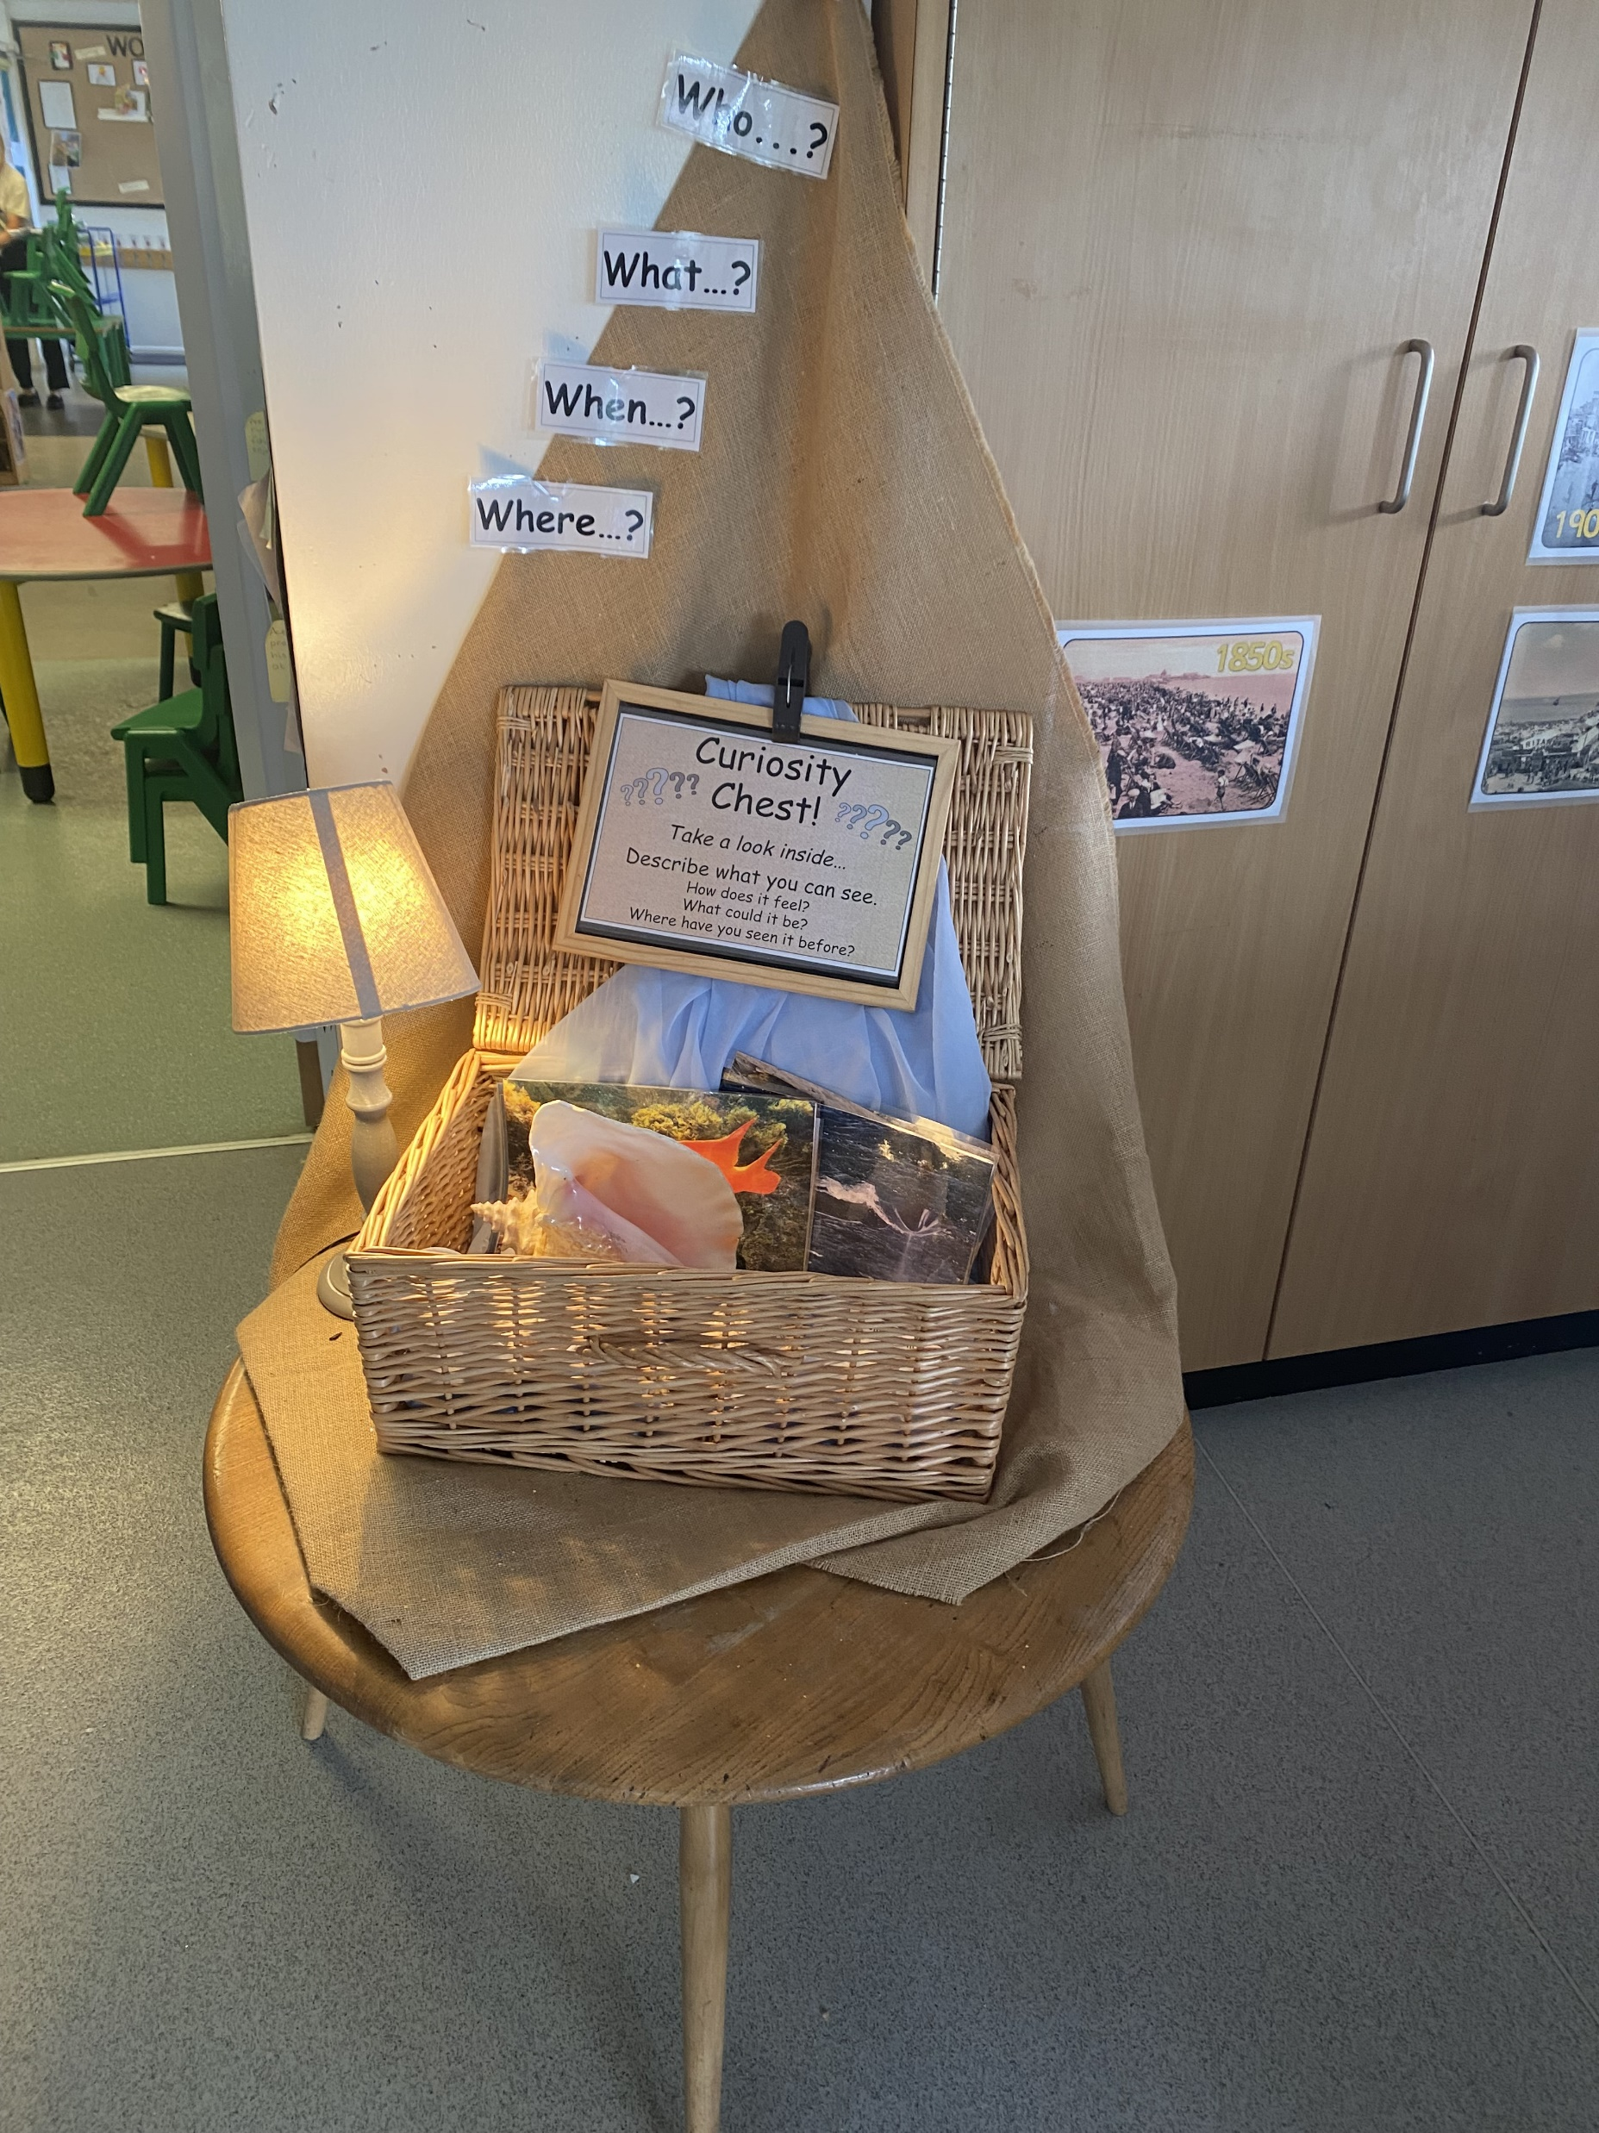
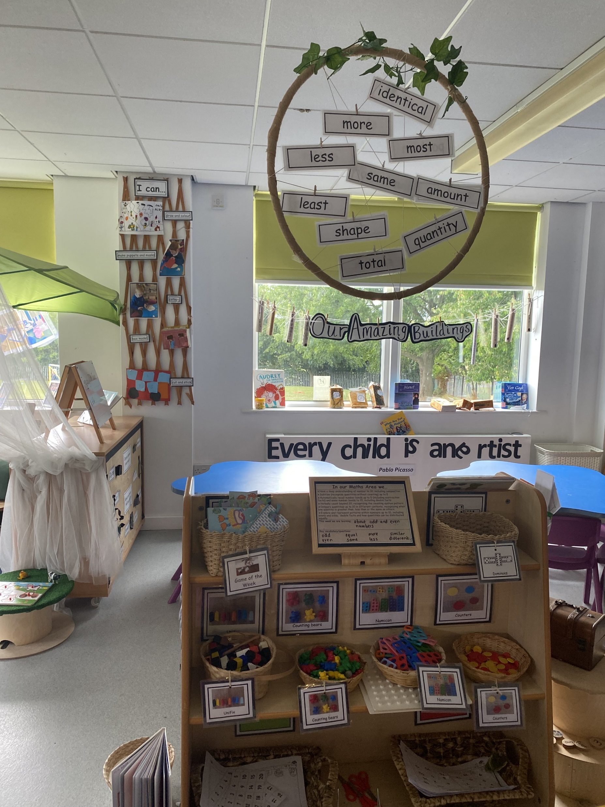
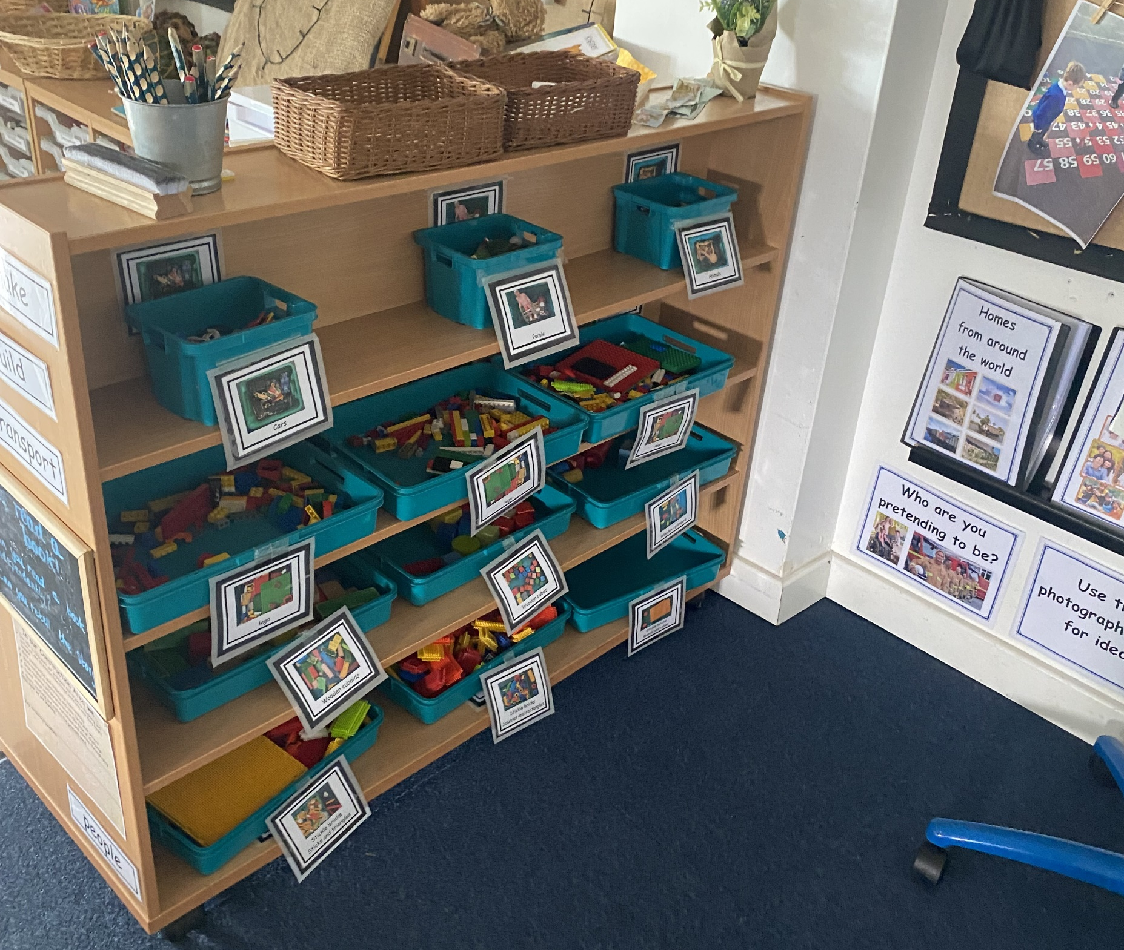
Reception Classroom

Slide 10
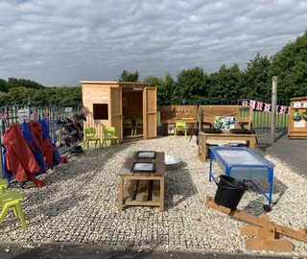
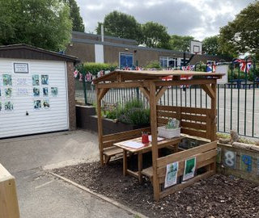
The Outside Area
The outdoor area is an extension of the indoor area and is used in all weathers – so long as it is safe!
Therefore, please ensure that your child wears an appropriate coat and footwear.
We provide waterproof clothing for our water area and wellies for the sand area but we do not have enough for all children to use these for general playing outdoors.

Slide 11
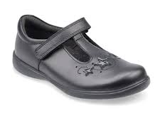
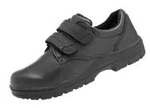
School Uniform
Shoes - We ask that all children wear plain black school shoes. Trainers may only be worn on the designated PE day. Children should not wear shoes with heels, open toed sandals, flip flops or wheelies as these are not safe for wear at school.

Slide 12


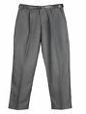

School Uniform
Pupils have the option to wear grey trousers, a grey pinafore dress or a grey skirt. Please do not wear leggings or jeans style trousers as these are not considered to be uniform. If wearing a skirt or pinafore, please ensure that it is knee length.
Pupils may wear a royal blue jumper, sweatshirt or cardigan. This can be plain or with the school logo. Pupils may wear a white or a pale blue polo shirt.
Socks should be white or grey. Grey tights may be worn.
Outdoor wellington boots can be worn if the weather is muddy; these must be changed into appropriate shoes inside.
In the summer term a summer school dress may be worn. This should be blue checked or striped.
Please label cardigans/jumpers/coats etc with your child’s name!

Slide 13

PE
Outdoor PE will be every Friday from Week 2 (Friday 16th September).
Children should come to school wearing their PE kit consisting of:
A plain white round neck t-shirt (no collar or buttons)
Plain navy/black shorts or jogging/tracksuit bottoms depending on the weather/season
Navy/black plain hoodie/jumper – again weather dependent
Sensible trainers for running in - any colour is fine and ideally velcro.

Slide 14

Jewellery
Please note that, in line with our school policy, wearing jewellery is not allowed in school, except for small ear studs. No neck, wrist or finger jewellery should be worn.
This also includes plastic dress up jewellery.

Slide 15
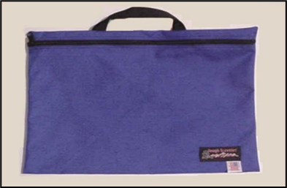
School Bag
Your child needs a book bag in order to bring their school reading books home. Book bags can be any colour or be themed e.g. Spiderman, Smiggle etc. They should be brought to school daily unless told otherwise.
A small keyring can be added to the handle of your child’s bookbag to help them to recognise it at home time
as they are encouraged to find their own.

Slide 16

Water Bottles
Your child needs to bring a water bottle to school with them each day and should contain only water. Children can then have a drink whenever they want one and can re-fill their bottle with fresh water as and when necessary.
Water bottles should have a sports cap to encourage independence and discourage spillages.
Your child’s name should be written onto the bottle.

Slide 17


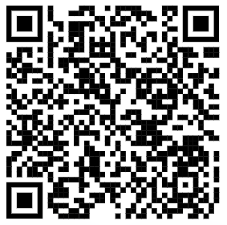
Milk and Fruit
Milk and fruit are available every day.
School milk is currently 24p per carton.
If your child turns 5 in the coming term, then you will have to start paying for milk if your child wants it.
Please register with Fresh Pastures via our website –
https://ashgrove.ipmat.co.uk/parents/school-milk/
Children in receipt of Free School Meals, who would
like milk at school, must inform the office – no need
to register with Fresh Pastures.
Please inform the office and staff if your child has any allergies or intolerances e.g. milk allergy, asthma, hayfever etc – this information should already be on your child’s records from the paperwork you completed.

Slide 18
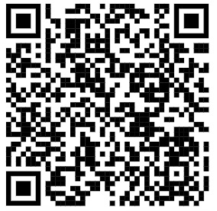
School Dinners
At Ash Grove, our school dinners are cooked fresh on site by Dolce/School Grid.
Universal Infant Free School Meals (UIFSM) are available to all pupils in Reception, Year 1 and Year 2. Funding is provided to school directly and is used to provide free school meals to infants in all UK schools.
Free School Meals (FSM), on the other hand is financial support provided to children of families who fall under certain qualifying criteria. These criteria, and more information can be found on the website below.
While parents may not need to apply for FSM for their child if the child is still young enough to receive UIFSM, it is still important to tell the local authority if your family falls under any of the qualifying criteria. You may be eligible for free school milk, free breakfast club and free Holiday Activity and Food (HAF).
Additionally, our school will receive pupil premium funding
for every child registered for FSM.
If you think your child may be eligible for Free School Meals,
make sure to apply here:
https://www.gov.uk/apply-free-school-meals
You can also contact the Free School Meals Team
by email - FSM@wakefield.gov.uk

Slide 19
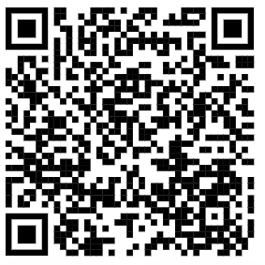

School Dinners
Ideally, children having school lunches will order beforehand online at home.
You can order daily or for the full week. This works best for our youngest children as often we find they don’t know what they want or they might choose something they don’t like.
If you do pre-order and your child is absent from school, please remember to log into your account and delete the order.
Visit our school website for further information - https://ashgrove.ipmat.co.uk/parents/school-dinners/

Slide 20

Packed Lunches
Packed lunches can vary and are made up around what each child likes to eat. These things should not be in packed lunches:
Drinks of any kind - your child has their school water bottle (which should contain water and not juice)
Sweets
Chocolate bars - chocolate biscuits such as Kit Kats are ok.
Packed lunches are kept in the EYFS kitchen
for the day, in our coolest area, however you
can add ice packs to them if you choose to.
Children have around 30 minutes to eat their
lunches. If they need longer than this, they
can continue to eat their lunch when the
other children go to play out.
They are never rushed.

Slide 21


Attendance
Attending everyday is really important.
However, if your child is suffering from any infectious diseases, bad colds/coughs, sickness or diarrhoea, please don’t send them to school as these can easily spread to other children.
You must keep your child at home for 48 hours after the last bout of sickness and/or diarrhoea.
If your child is unwell please
telephone the main office:
01977 640625

Slide 22

Breakfast Club
Children can attend Breakfast Club from 7.45am
It takes place in the school hall and is supervised by school staff.
Children will play with things they are interested in e.g. board games, books, puzzles etc and will also eat breakfast in this time (toast and/or cereal with a drink)
Children will be taken to their class in time for school starting.
Breakfast Club does not need to be booked in advanced. Simply bring your child to the main office any time from 7.45am
Breakfast Club costs £2.50 per day and is payable via Scopay.

Slide 23
Communication with Parents
We endeavour to speak with you as often as we can.
As we will see you on a daily basis, quick messages can be given. However staff will not have the time to meet with parents/carers when they are ensuring children enter and exit safely – please make contact via Tapestry/school office should you require a meeting.
Tapestry - we share all information about your child’s learning and development through Tapestry – this could range from daily to weekly depending on activities carried out/photos taken etc
Open evenings – we will meet formally twice each year to discuss your child’s learning and development
Emails/calls to the office – please use this method for reporting your child’s absence, queries around aspects such as school events etc
Dojo – we award Dojos for positive behaviour and you can receive these alerts on your phone. The messaging service can be used however this is not always checked (use Tapestry/call/email the office first).

Slide 24

Communication with Parents
We record photos/videos on Tapestry – this ensures the best possible communication with Parents and Carers when it comes to sharing evidence around learning and development.
Two-way process - Parents and Carers are encouraged to add photos and videos to show learning and development at home - children love to stand at the front and show these to the class!
If you cannot yet access Tapestry then please download the App – should you require any technical/log in advice then please contact Mrs Horne in the office for support.

Slide 25
Early Years Curriculum
Activities in Reception are carefully planned and organised in order to provide a range of learning experiences. Individual records are kept by staff to record the activities your child participates in and undertakes, as well as their progress in specific skills.
Planning is carried out using a topic-based approach, following the children’s interests and responding to specific events.
There are 7 Areas of Learning in the Early Years Foundation Stage (EYFS), which activities are planned around:
Personal, Social and Emotional Development
Physical Development
Communication and Language
Literacy
Mathematics
Understanding the World
Expressive Arts and Design
Throughout the EYFS, children will be working towards the Early Learning Goals. These describe the level of attainment expected at the end of your child’s reception year in school.

Slide 26


Reading in Reception
We are a Read Write Inc school. This is the systematic approach that we use to teach children phonics each day.
We use Read Write Inc Phonics (RWI) to give your child the best possible start with their literacy.
RWI is a literacy programme which helps children learn to read fluently and at speed so they can focus on developing their skills in comprehension, vocabulary and spelling.

Slide 27

Reading in Reception
Mondays – Your child will choose a school library book to take home and share with you. These will usually be worded story books for you to read to your child to develop a love of reading and enjoy story time together.
Fridays – A school reading book will be given.
These books will be in line with the RWI
phonics books that your child will be reading
in daily phonic session. Your child will have
a reading journal for you to write down any
comments about your child’s reading at
home. Our school expectation is that children
will read at home 3 times each week.

Slide 28
Developing Independence
How you can help your child prepare for school…
Children will be encouraged to organise their own food at lunch time e.g. open wrappings – staff will help but children might need to wait.
Children will use the toilet independently, including wiping own bottom and flushing the toilet.
Practise taking own shoes on and off – ones with velcro!
Practise taking own coat on and off and any extras such as gloves.
Children need to be able to wash and dry own hands thoroughly.

Slide 29

Any Questions?

